Slide 1
Full Stack Development with MERN Stack
A Formal Project Presentation

Slide 2
Introduction to Full Stack Development
Full stack development involves both frontend and backend technologies.
MERN Stack is a powerful JavaScript stack comprising:
- MongoDB
- Express.js
- React.js
- Node.js

Slide 3
Project Objective
To develop a dynamic web application using MERN stack that offers full CRUD functionality, authentication, and seamless user experience.

Slide 4
Problem Statement
Modern applications require scalable, fast, and interactive platforms.
The challenge is to develop such a solution using a single language (JavaScript) throughout.

Slide 5
Proposed Solution
Use MERN stack to build a full-stack web application with:
- MongoDB for database
- Express.js and Node.js for backend
- React.js for frontend

Slide 6
System Architecture
Frontend (React) ↔ Backend (Node + Express) ↔ Database (MongoDB)
RESTful APIs connect frontend and backend.
JWT for authentication.
Hosting via Render/Vercel.

Slide 7
Technology Stack
- Frontend: React.js,Tailwind CSS
- Backend: Node.js + Express.js
- Database: MongoDB
- Tools: Git, GitHub, Postman, JWT, Tailwind

Slide 8
Key Features
- User Sign-Up , Sign-In.
- Dashboard with analytics
-Different page for Income and Expense with CURD
- API Integration
- Responsive UI

Slide 9
Development Workflow
1. Setup React frontend
2. Create Node.js + Express backend
3. Connect MongoDB
4. Build REST APIs
5. Implement frontend integration
6. Test and deploy

Slide 10
Codebase Overview
- Frontend: Components, Pages , Hooks , Context ,Constant, Utils,
- Backend: Routes, Controllers, Models, Config, Download , Middleware.
- Shared: .env

Slide 11
Testing and Debugging
- Manual Testing (Frontend & Backend)
- Postman for API Testing

Slide 12
Deployment
- Frontend: Vercel
- Backend: Render/Heroku
- Database: MongoDB Atlas
- Version Control: GitHub

Slide 13
Challenges Faced
- State Management
- Deployment Syncing
- Axios Request

Slide 14
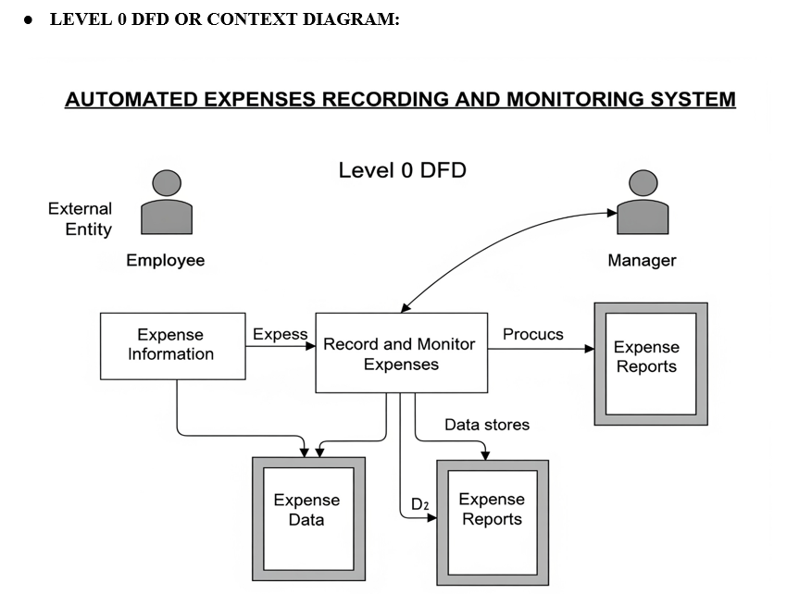
LEVEL 0 DFD STRUCTURE

Slide 15
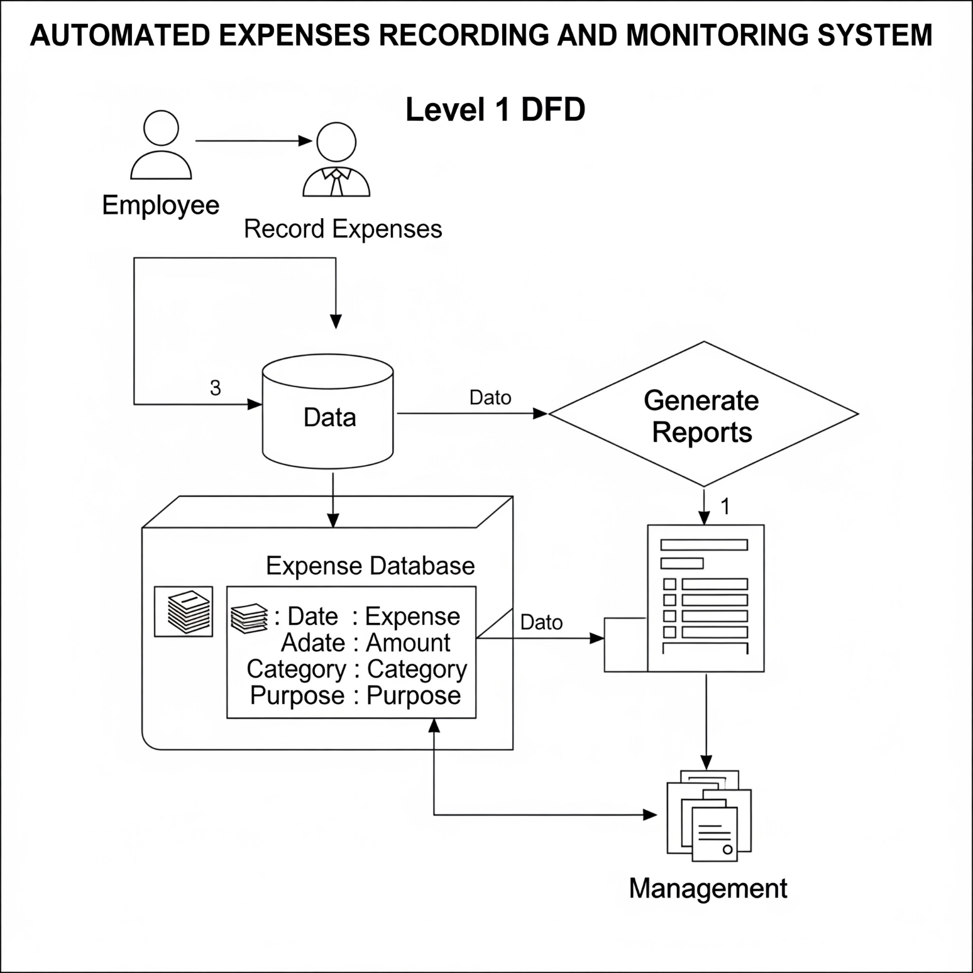
LEVEL 1 DFD STRUCTURE

Slide 16
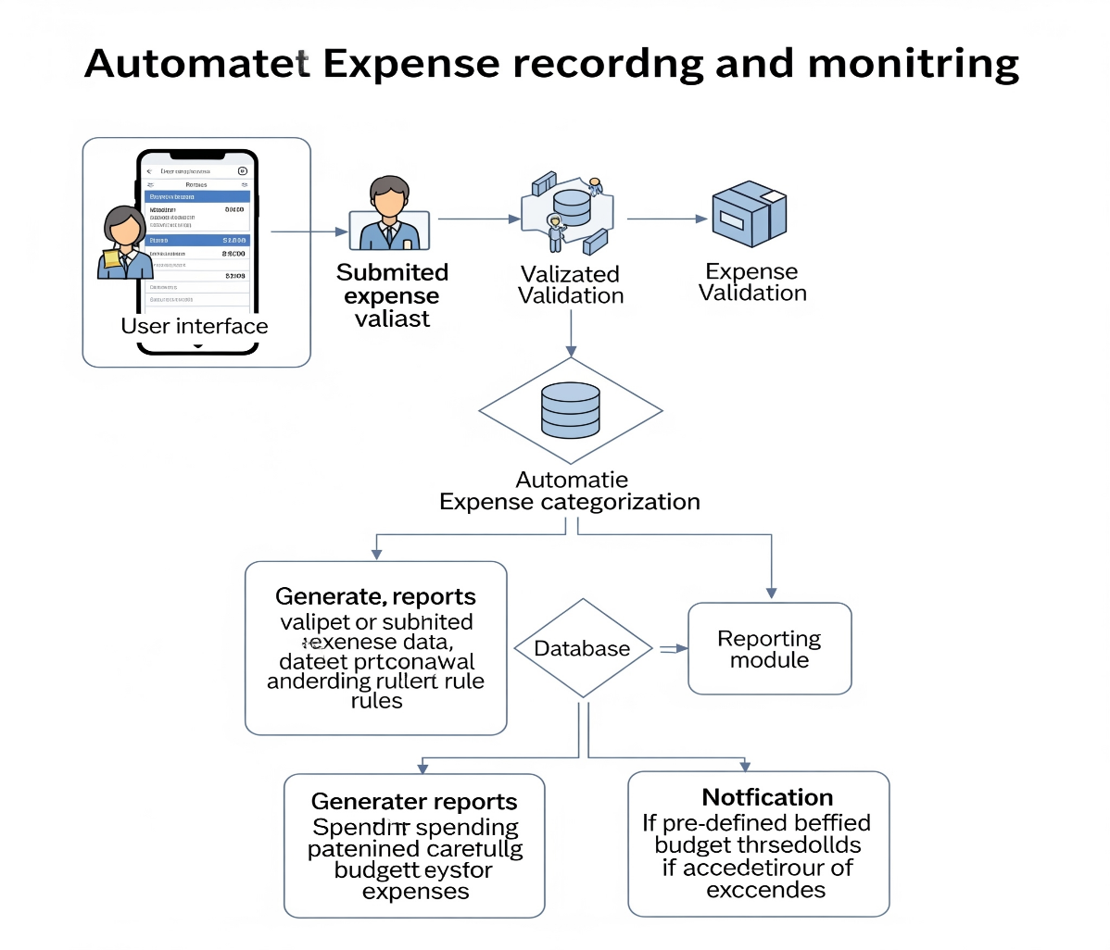
SEQUENCE DIAGRAM

Slide 17
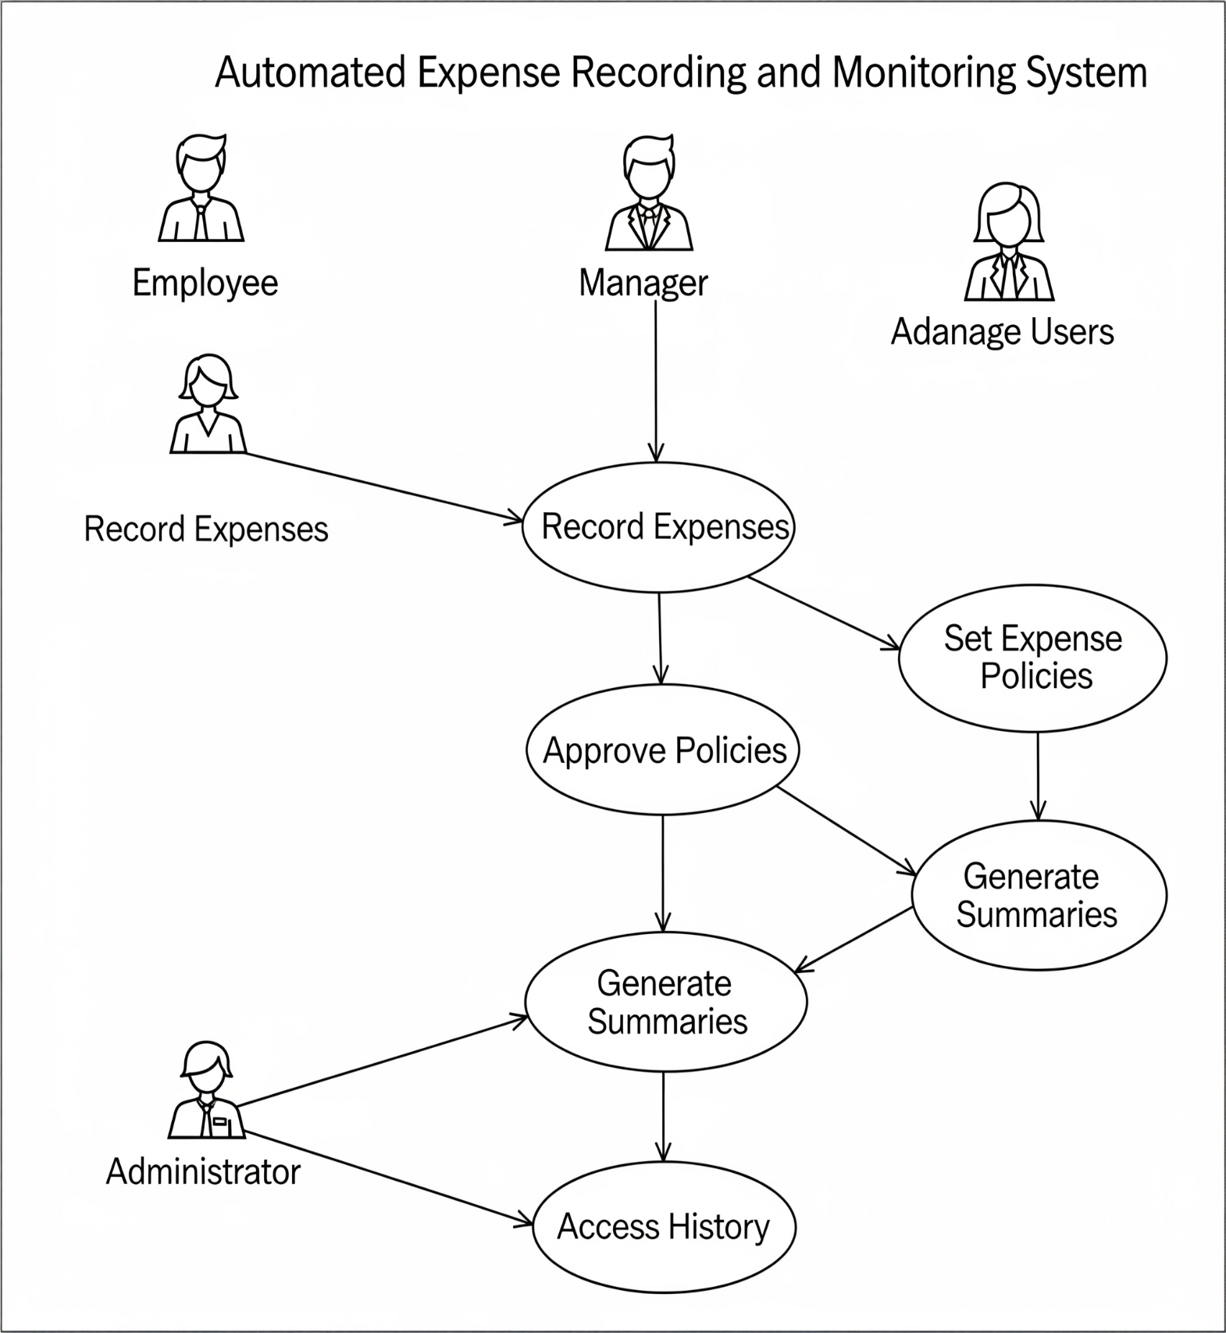
USE CASE DIAGRAM

Slide 18
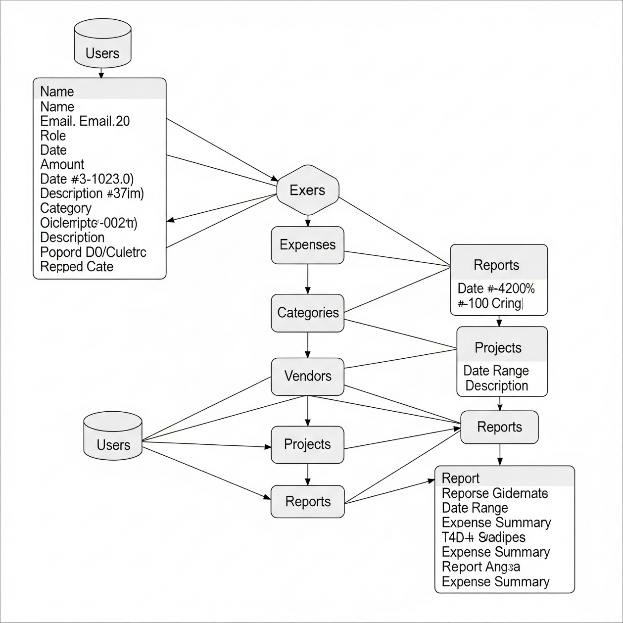
SCHEMA DIAGRAM

Slide 19
FINSIGHT(AUTOMATED EXPENSES RECORDING AND MONITORING SYSTEM)
Built With Logic and Designed with passion
FinSight is a modern and intuitive personal finance management web application designed to help users take full control of their income and expenses. Whether you're tracking daily spending, analyzing income trends, or aiming for savings goals — FinSight empowers you to manage money with clarity and confidence.

Slide 20
OBJECTIVE
Streamline Expense Recording: To provide an intuitive and efficient way for users to record expenses, minimizing manual data entry and reducing the time spent on administrative tasks. This includes supporting various input methods like manual entry and automated data extraction from receipts (OCR).
Improve Data Accuracy: To minimize errors associated with manual data entry through automation, validation rules, and AI-powered data extraction, ensuring that financial records are precise and reliable.
Enhance Financial Visibility: To offer real-time insights into spending patterns, categorized expenditures, and overall financial status through comprehensive reports and dashboards, enabling better financial planning and decision-making.
Facilitate Budget Adherence: To enable users and administrators to set and monitor budgets effectively, providing automated alerts and notifications when spending approaches or exceeds predefined limits, thereby promoting fiscal responsibility.
Accelerate Reimbursement and Approval Processes: To automate and expedite the expense approval workflow, ensuring timely processing of expense claims and quicker reimbursements for employees.

Slide 21
​UI SNAPSHOT

Slide 22
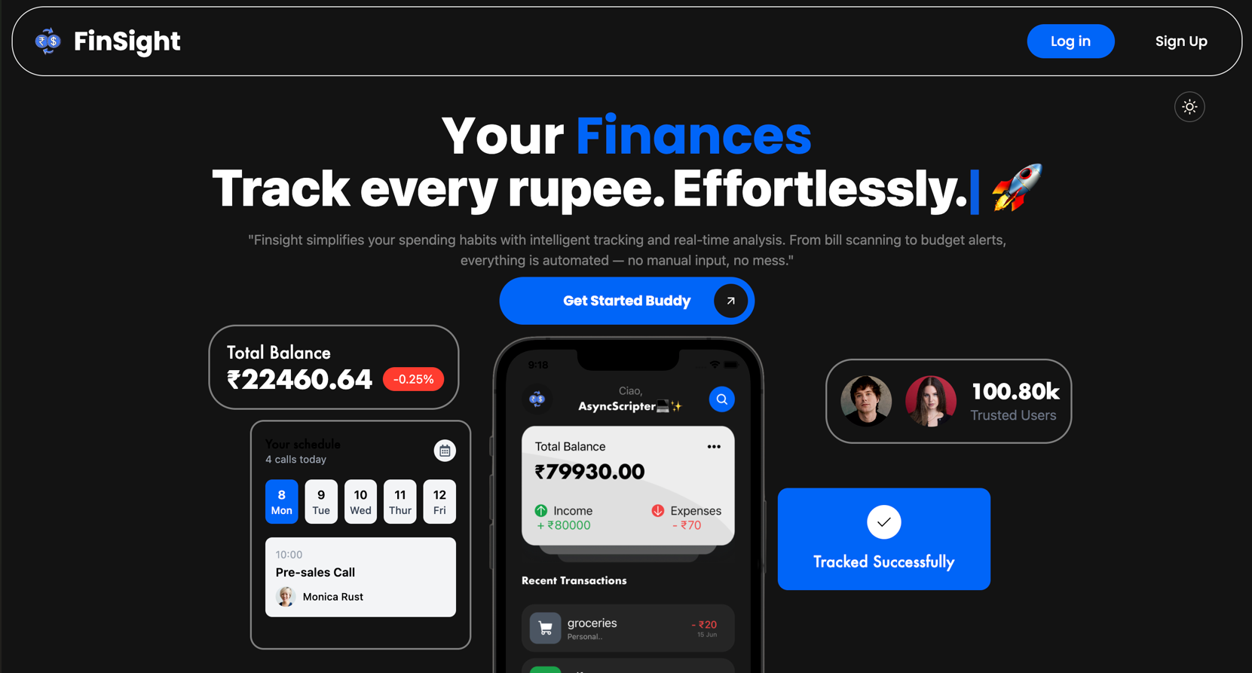
WELCOME PAGE

Slide 23
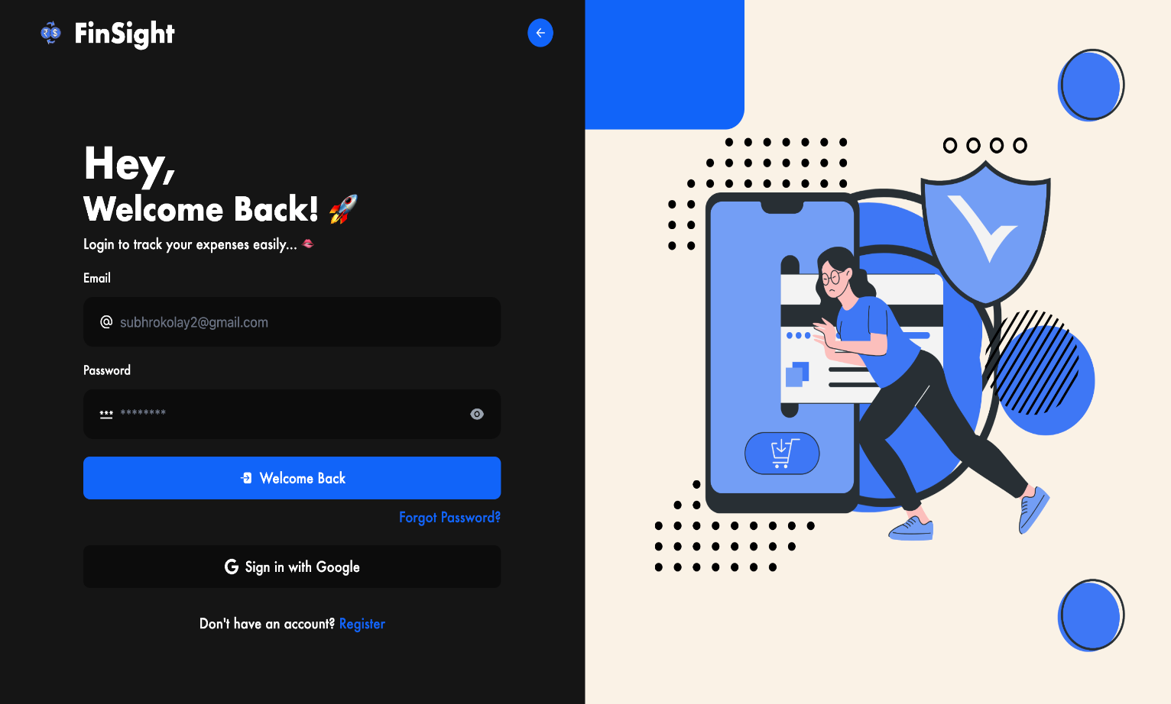
LOGIN PAGE

Slide 24
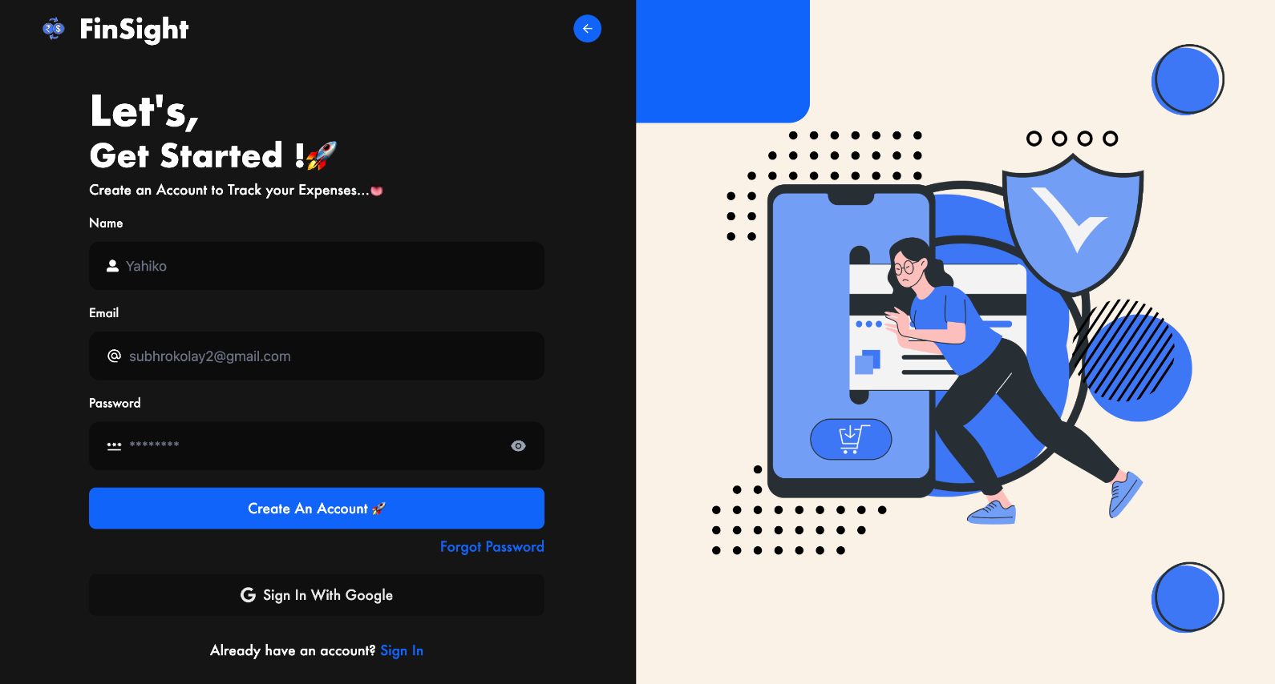
SIGN-UP PAGE

Slide 25
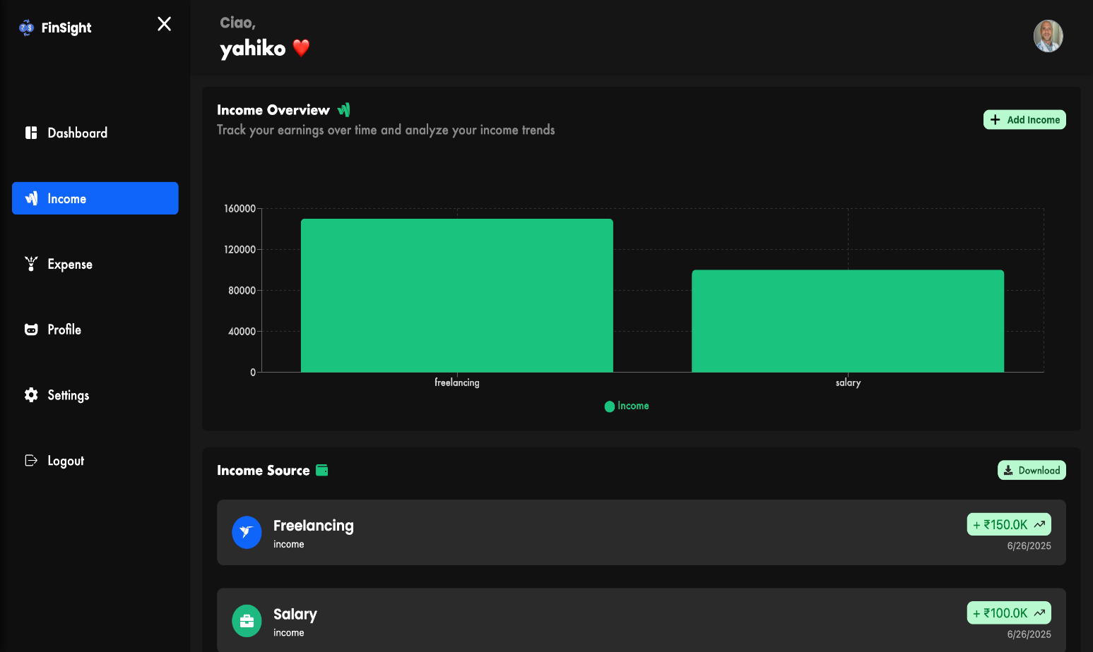
INCOME PAGE

Slide 26
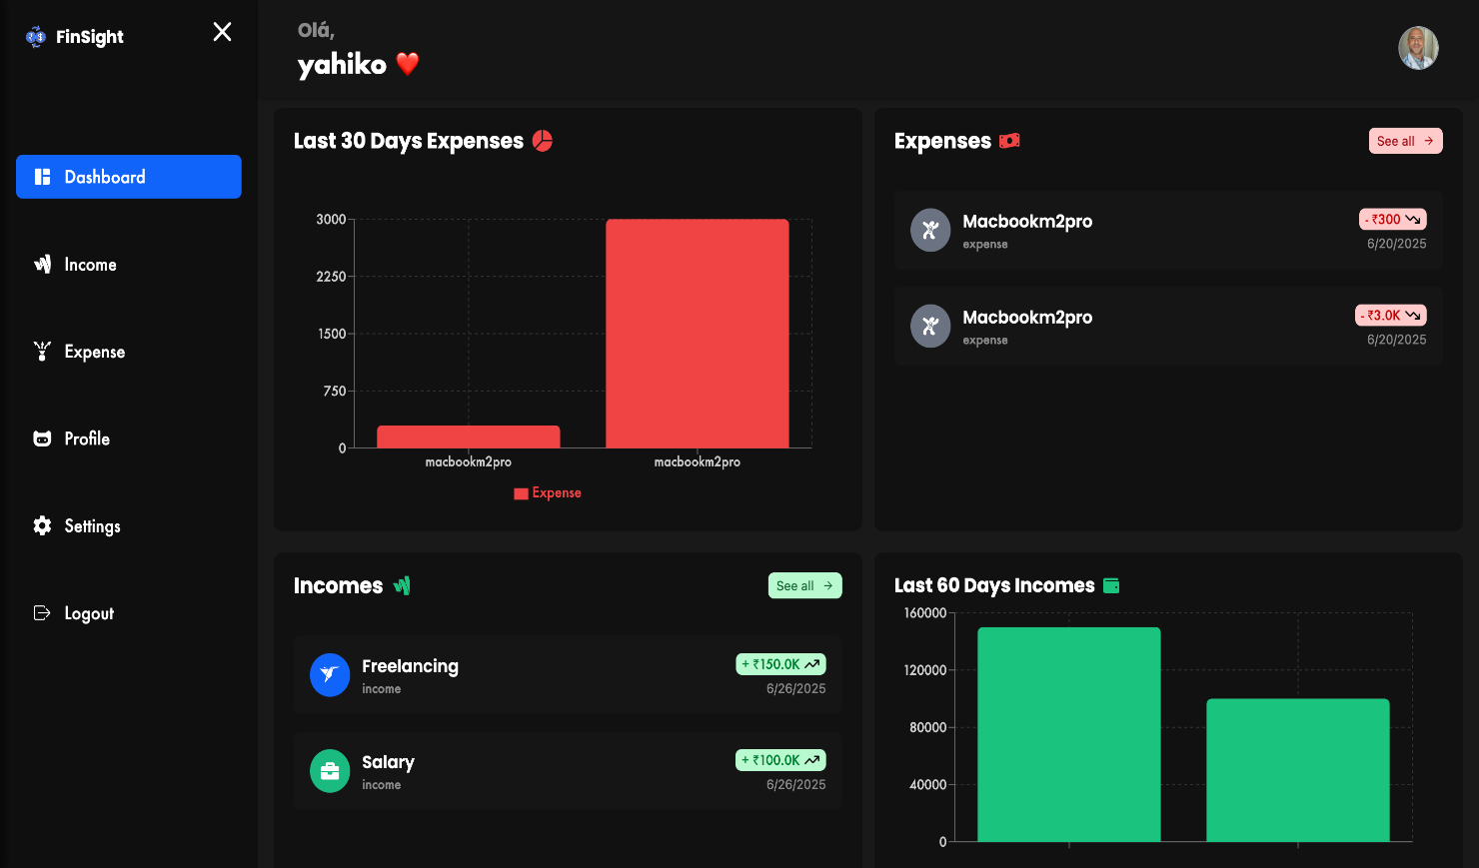
DASHBOARD

Slide 27
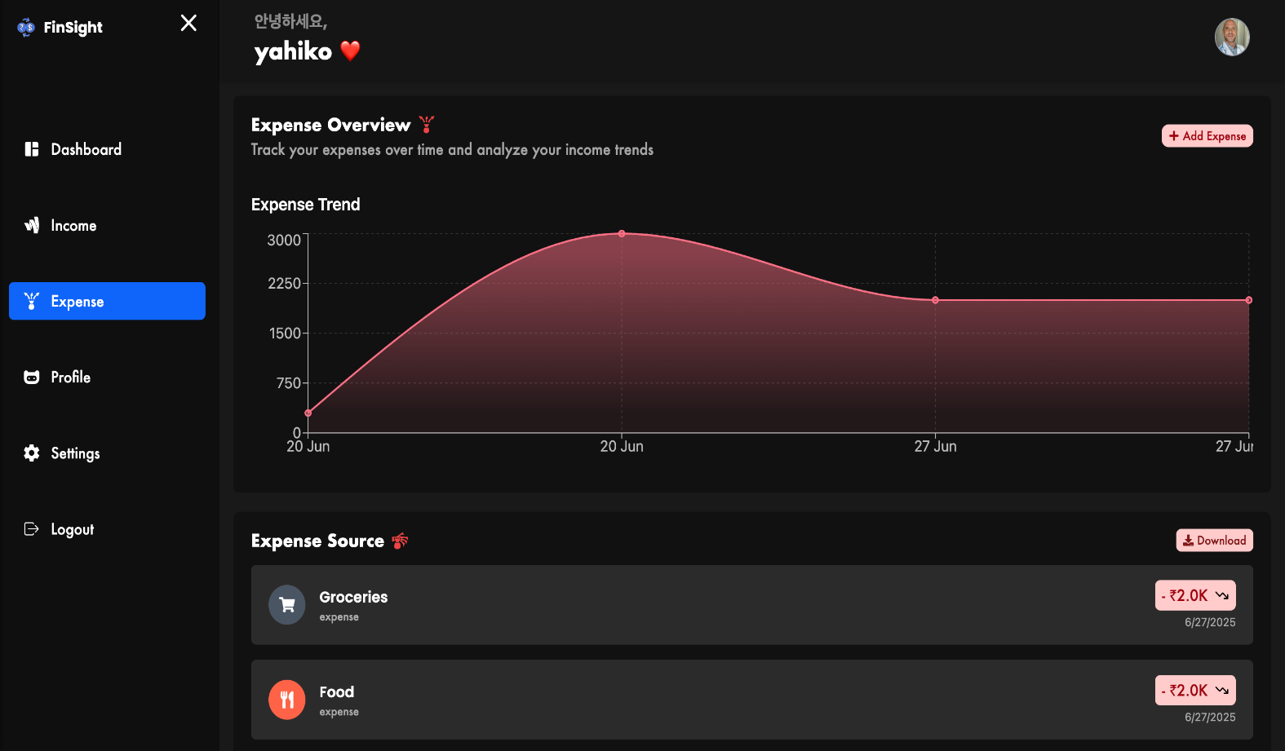
EXPENSES

Slide 28
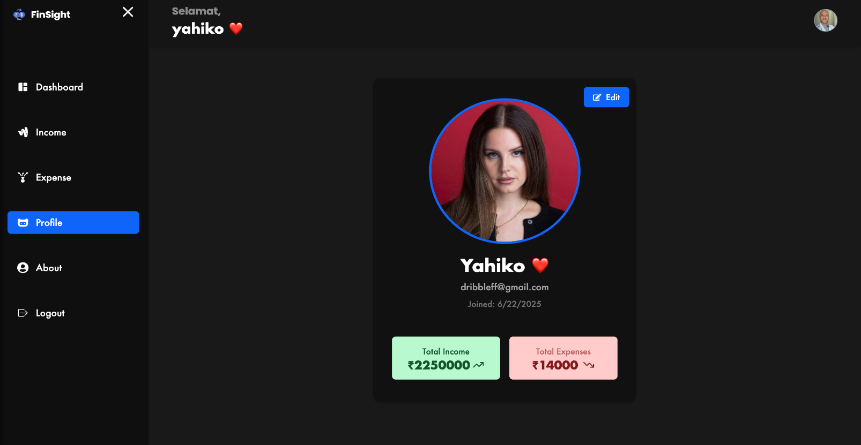
PROFILE PAGE

Slide 29
BACKEND

Slide 30
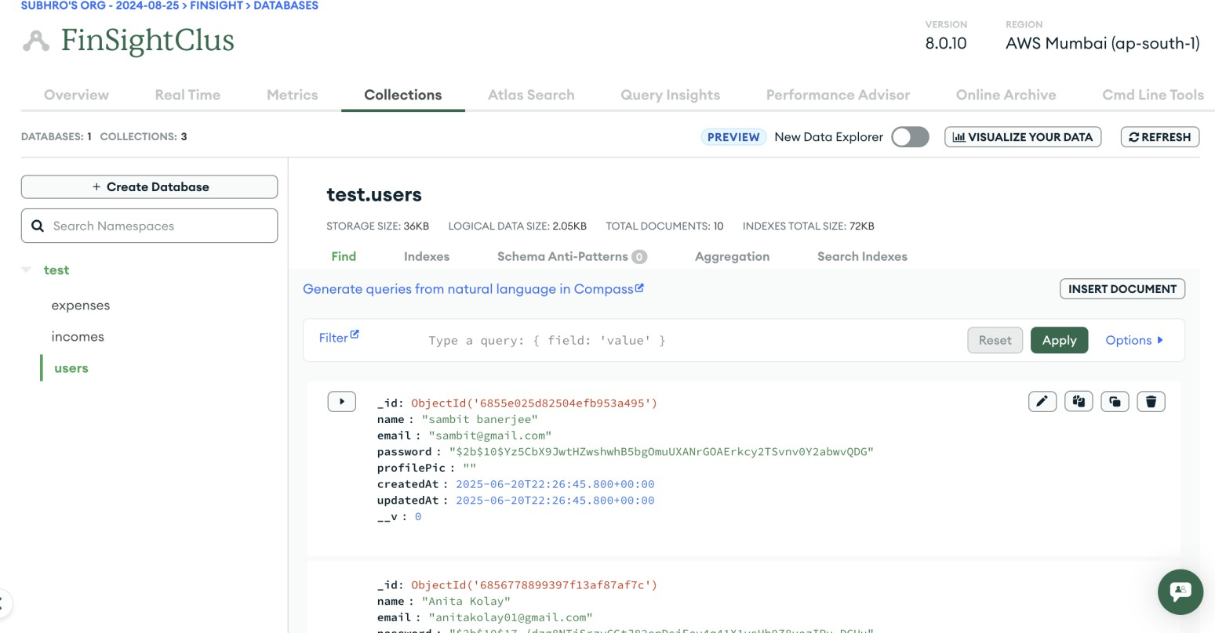
USER DATA

Slide 31
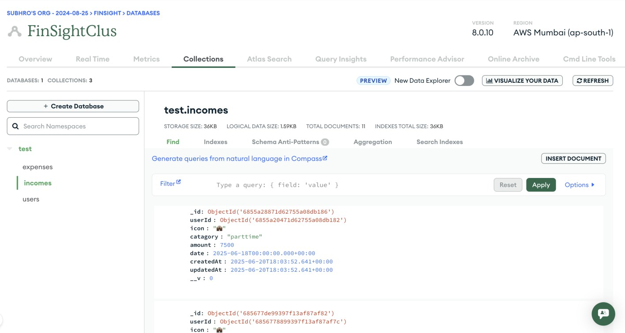
INCOME DATA

Slide 32
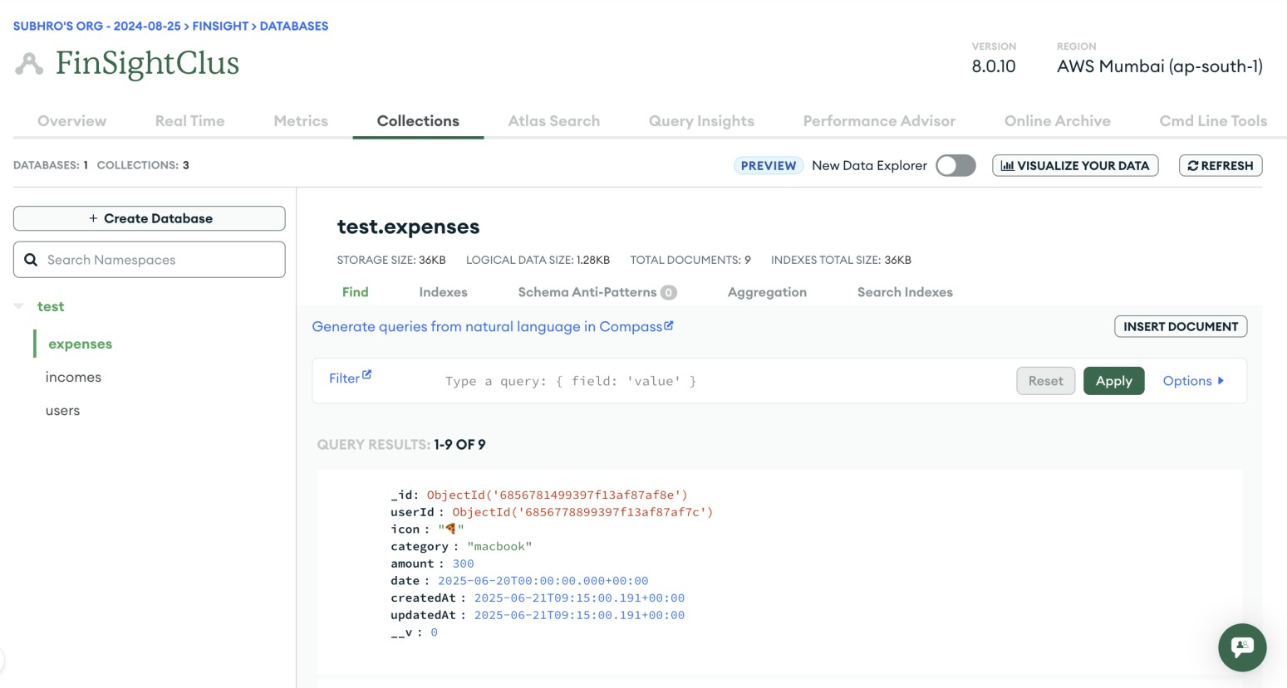
EXPENSES DATA

Slide 33
Future Scope
- Add Real-Time Features with Web Sockets
- Use TypeScript for type safety
- Add OCR to interpret images
- Add Subscription for users to use AI Features
- Integrate multiple platform authentication (GitHub ,Facebook)

Slide 34
Conclusion
This project demonstrates a complete MERN stack application from development to deployment.
It highlights the benefits of full-stack JavaScript development.

Slide 35
References
- https://reactjs.org
-- https://nodejs.org
- https://expressjs.com
-- https://www.mongodb.com
- YouTube tutorials
https://www.youtube.com/watch?v=T55Kb8rrH1g&list=PLbtI3_MArDOkXRLxdMt1NOMtCS-84ibHH

Slide 36
Thank You

